Slide 1
A Practical Review of the New Skills for Success Curriculum Resources From Community Literacy of Ontario
PRESENTED BY: JANE TUER
Notes:
Hello and welcome everyone! Thank you all for joining us today for our webinar on the new Skills for Success Curriculum Resources, presented by Jane Tuer!

Slide 2
Let’s Get Connected!
Twitter
Our Website
SCAN OUR QR CODES TO FOLLOW US!
To Scan: Open you phone camera and zoom in on the code then press the link!
Instagram
Meta/Facebook
Notes:
If you don’t already follow CLO online, now is a great time to follow our social media channels, where you will get updates on sector news and all of our webinars and resources! And, keep an eye out in March for CLO's new website launch! All of our resources will be even easier to navigate!

Slide 3
Acknowledgements
Thank you to the Ministry of Labour, Immigration, Training and Skills Development for supporting Community Literacy of Ontario.
The Government of Ontario and its agencies are in no way bound by the recommendations contained in this event. The views expressed in this session do not necessarily reflect those of the Province.
This Employment Ontario service is funded in part by the Government of Canada and the Government of Ontario.
Notes:
I’d like to acknowledge our funder, the MLITSD, and note that the views expressed in this webinar do not necessarily reflect those of the Province.

Slide 4
Housekeeping:
The Resources:
www.communityliteracyofontario.ca/skills-for-success/
Q&A session​
ASL Interpreters​
Recording​
Evaluation
Notes:
Some brief housekeeping notes:
Instead of traditional handouts, the resources covered today can be found at the link on the screen, and I will drop a clickable link in the chat.
There will be a brief Q&A at the end of the webinar, please enter any questions into the chat and I will moderate those questions at the end of the presentation.
Today we have ASL interpreters, thank you to our two interpreters for being available today. Please be sure to pin both interpreters in your Teams application to keep them on your screen.
Today’s session will be recorded and will be available on CLO’s website for anyone to view. It will be available usually within two to three weeks. We will also be providing a PDF version of the slide deck as a handout, which will also be available on CLO’s website.
And last but not least, there will be an evaluation poll at the end of the webinar – it only takes a few moments to complete and is great information for us to receive. So, please complete the evaluation poll during the Q&A session before exiting the webinar.

Slide 5
Introductions
Host
Presenter
Catherine Toovey
CLO
Jane Tuer
Project READ
Notes:
Hello and welcome!
I am Catherine Toovey the Executive Director of CLO and I want to welcome and thank everyone who is able to join us live today.
I am very pleased to introduce our special guest speaker Jane Tuer, the Executive Director of Project READ, beaming in from Kitchener! Many of you are likely familiar with Jane, she has been working in the literacy field for over 25 years and today she will be sharing some of her vast knowledge of the new Skills for Success curriculum resources developed during the 2022-2023 project and the current 2023-2024 project.
And now, without further ado, I will pass the metaphorical mic over to our fantastic guest speaker, Jane Tuer!

Slide 6
Land Acknowledgement
Community Literacy of Ontario recognizes that its work, and the work of its member agencies takes place on traditional Indigenous territories across the province. We acknowledge that there are 46 treaties and other agreements that cover the territory now called Ontario. We are thankful to be able to work and live in these territories. We are thankful to the First Nations, Metis and Inuit people who have cared for these territories since time immemorial and who continue to contribute to the strength of Ontario and to all communities across the province. CLO is honoured to collaborate with Indigenous clients, stakeholders and communities throughout the various territories.
Notes:
Jane: Before going forward I would like to do a Land Acknowledgement:

Slide 7
Categories
Apprenticeship
Digital Delivery
Under-Represented Groups
Workplace
Notes:
Community Literacy Ontario developed a variety of curriculums over 2023 that focus on the new Skills for Success which as we know align perfectly with the Ontario Adult Literacy Curriculum Framework and levels.
However, as adult practitioners we have a tendency to use curriculums for the more obvious audiences. Meaning if we say these materials are for Apprenticeship then why would I use them with someone working on Independence or towards Secondary School credits?
This means we’re missing out on the adaptability of a variety of excellent materials to use in the classroom.
One of the first things you learn in adult literacy is that adults learn differently than children. They bring life experience and knowledge and skills to the classroom or learning situation and need to see how what they’re doing relates to their goals.
How many times have you actually used a curriculum the exact way it was written? Maybe at first, but then you start adding in your own spices and ingredients just like we do when we’re cooking. We like to mix it up and make it more fresh. So let’s look at how the current curriculums that were developed can be used in other ways.

Slide 8
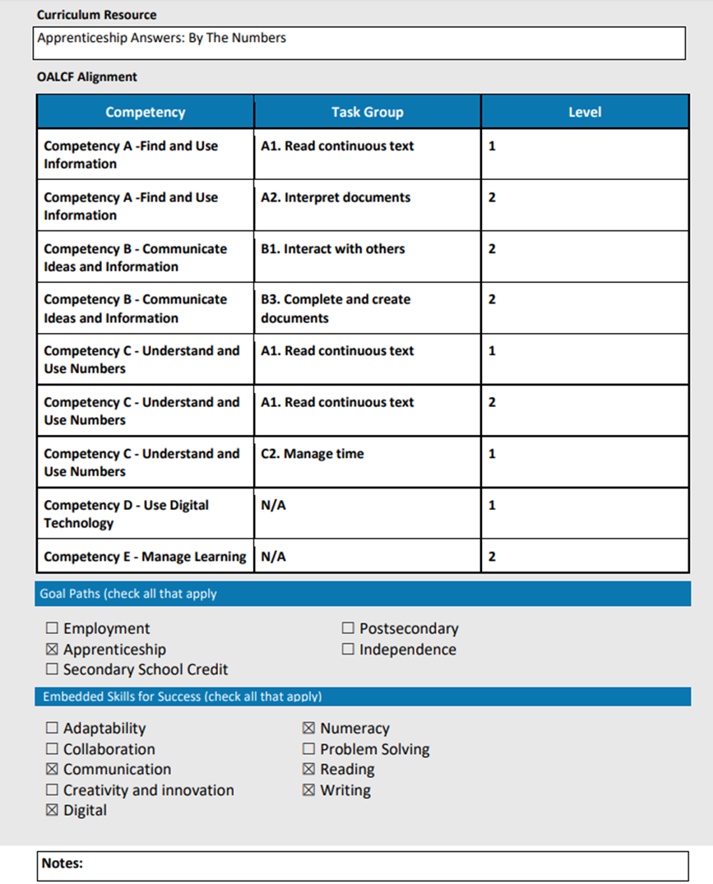
Cover
Pages
Notes:
Each curriculum has this cover page….in this case we’re focusing on the Apprenticeship Answers: By the Numbers
It starts with the OALCF competency….task group…..and level
Next the goal path focus
And finally the Skills for Success that are present in the curriculum

Slide 9
Skills for Success
Adaptability
Numeracy
Collaboration
Problem Solving
Communication
Reading
Creativity & Innovation
Writing
Digital
Notes:
The former Essential Skills have had a facelift
Some have remained the same like
Reading
Writing
Numeracy
Then some have had slight changes
Thinking Skills has become Problem Solving
Computer Use has become Digital
Oral Communication has just become Communication
Working with Others has become Collaboration
Some new ones have been added
Adaptability
Creativity and Innovation
Some are now not listed
Document Use that was found to be embedded in many of the Skills for Success like Reading and Writing
Continuous Learning – not always seen as a skill but a process for learning skills

Slide 10
Apprenticeship
Apprenticeship Answers
Exploring Apprenticeship
Skills for Apprenticeship Success
By the Numbers
Putting Your Best Foot Forward
Notes:
Of the 6 – 4 are definitely versatile enough to be used with other goal paths
Let’s look at them more closely

Slide 11
Exploring Apprenticeship
Explore careers based on work interests
https://www.jobbank.gc.ca/workpreference
And related activity
Notes:
The job bank quiz on work interests is great for learners on the employment, secondary school credits and post secondary path. It is very rare to have an adult in our program choosing the education goal paths without it being related to employment in the longer term.
Having learners on any goal path outside of Independence could follow this directly. Independence might also find the quiz interesting for work preferences as it shows how we prefer to do things, very much like personality quizzes.
Let’s look at the related activity and see how it could be adapted….

Slide 12
Notes:
The only question specific to apprenticeship is the 3rd one and you can take that out.
To adapt it for independence you can keep task 1. And then make it more specific to them based on their goals. I had a learner that’s main goal for independence was to be able to handle their own finances.
So if they like to work in a more social way….what are some steps they can do to develop a budget?
How about if they like to work in a more methodical way to develop a budget?
How about Innovative?
You can see how this can take learning and teaching in a more creative fashion – keeping it interesting for you both
It can be a different look at learning styles.

Slide 13
Skills for Apprenticeship Success
All about Self-assessment
Notes:
Not just skills for apprenticeship alone….it’s completely adaptable for all skill paths
Let’s look at the example on the next slide

Slide 14
Notes:
This is the one that explores problem solving….it does ask about “organize job tasks according to their level of priority”….but that’s something we have to do everywhere, it’s not just about on-the-job

Slide 15
Notes:
While there are many mentions of apprenticeship work…..there is a great budget list….that’s a fillable PDF. That’s usable for all goal paths.

Slide 16
Putting your best foot forward
Learners think about how they use the SFS in learning
Section on soft skills
Notes:
-this is a great match up for all goal paths with Manage Learning
-the soft skills section covers:
Working with other people
Dealing with change
Getting ahead of problems
Building your creativity
Asking questions
Non-verbal communications and
Looking at yourself outside of work
The non-verbal communications starts with reading body language…..

Slide 17
Putting Your Best Foot Forward
Notes:
Then the next page asks you questions like:
Who looks like they want to talk to you?
What gives you that impression?
Etc.
The pictures are excellent for this and saves you time when you’re talking about non verbal communications to your learners

Slide 18
Skills for Success
in the Service Sector
Notes:
While the rest outside listed within the Apprenticeship section are mostly focused directly on apprenticeship….there is also the one written for the Service Sector
There’s a section at the beginning of this curriculum that explains each Skill for Success and gives the learner the opportunity to think about how they’re currently using these skills. And once again, it’s a fillable PDF.

Slide 19
Better Jobs Ontario
Module 1 – Digital skills
Module 2 – Skills for Success
Module 3 – Skills, Attributes and work values
Module 4 – career quest and counselling
Module 5 – education research
Module 6 – credentials and additional funding
Module 7 – budgeting
Notes:
Now while this was not created by CLO, there is only one curriculum in Better Jobs Ontario and it’s a full program curriculum with 11 modules. We’ve listed the modules that can be used with learners in all goal paths.
Module 1 teaches digital basics….opening, closing, saving, using a web browser, navigating websites, performing basic troubleshooting, a typing tutorial and more
Module 2 highlights….reading, writing and grammar, Math from addition to fractions to work problems to percent and integers (and then a section on math for the trades
Module 3 you can pick and choose what to use and the first ones are great for the employment path, but the learning styles assessment is applicable to every goal path
Takes you to the Canada Job Bank surveys for career planning
Then to career explorer
Then U of T self assessment
Then the Y’s learning styles assessment
Module 7 (yes I listed 4, 5 and 6 so you just didn’t think I’d forgotten them but they’re BJO specific) gives the learner the chance to express how they feel about money and how they spend and would like to save; setting some SMART goals financially and building financial literacy skills throughout
I’m sharing an example of this on the next slide

Slide 20
Notes:
This is from their budgeting module….it’s a great page to get discussions going about how people feel about money….excellent to add to a financial literacy program or math when you’re dealing with decimals (I always teach decimals as money for that familiarity piece)

Slide 21
Digital Delivery
Introduction to Android Phones and iPhones
Cybersafety 1 & 2
Introduction to Facebook
Introduction to Gmail
Introduction to Online Banking
Introduction to Video Calls
Introduction to Word Processing
Introduction to YouTube
Notes:
Introduction to Android Phones and iPhones – already covers Employment and Independence….but don’t forget this for Apprenticeship – they also have to use their phones to do many different things at work
Cybersafety 1 & 2 – this is an all round curriculum for understanding how to be safe online as every goal path will experience it
Introduction to Facebook is meant for independence and employment – businesses all have facebook pages – letting you know a lot more information about their business and interaction with their customers
Introduction to Gmail is meant for Independence and the Employment path, but all the other goal paths need to know this as well. In post-secondary you will have contact with your professors and classmates through email – it’s no longer okay to not just show up to class, you need to send an email to show professionalism. You may need to work remotely with other students and setting up a Zoom call everytime might not be possible, but an email can fill in those meeting gaps
Introduction to Online Banking….is set for Independence, but once again it will be used in many aspects of life – e-transfers happen from employers for payment….if you get a cheque from someone you will be scanning it more than likely for e-deposit. It’s something that’s useful to everyone
Introduction to Video Calls is meant for employment and independence, but since COVID many classes go online. Colleges don’t have the space for all classes to be in-person so many are also virtual.
Introduction to Word Processing – is stated to be for Independence and Employment, but let’s face it it’s used for Secondary School Credit and Postsecondary. Students need to know how to use this to complete reports and essays.
Introduction to YouTube – is for Employment, Independence and Secondary School Credit – but it’s also used in Postsecondary programs and by apprentices – trades people have posted a variety of videos on YouTube about new products for the trades and also some hacks…this site is useful to everyone

Slide 22
Under-represented Groups
Adapting to Change
Welcome and unwelcome change
Strategies for adapting to change
Plan and prioritize
Goal setting
Don’t give up
And activities
Notes:
Adapting to Change was written for all goal paths. While it certainly fits for many learners who would be seen as underrepresented groups, it can be used with all learners. Change is difficult – when I first was learning about the Essential Skills, now revised into the Skills for Change, the one thing that was emphasized is that we always expect individuals with the least amount of essential skills to constantly change and yet, without proficiency in the essential skills you are less likely to be able to change. This is important learning for all our adult learners in LBS.
Don’t give up section we have an example on the next slide

Slide 23
Notes:
It talks about it being hard to adapt to change and some tips to deal with change, including using 211 for finding help in your community
Referring learners to outside community supports can be as simple as helping them to contact 211.

Slide 24
Under-represented Groups
Building your skills through volunteering
Shows the employment skills you can build through various volunteer jobs
Building soft skills
Notes:
Many times people don’t think about volunteering to get an employment or continuing their education, but in the long run, most job postings want you to have experience….sometimes 2 to 3 years experience. Volunteering is a great way to gain these skills to add to a resume or a college application
Two examples of the jobs listed are:
-Charity thrift shop helper
Pricing
Retailing
Patience
-Foodbank warehouse helper
Organizing
Inventory
Reliability
Building soft skills through volunteering helps the learner to analyze and manage their own learning by deciding what soft skills to improve and how. Yet more things to add to a resume and cover letter. Especially with employers clearly stating that soft skills are the skills most missing from new hires.

Slide 25
Under-represented Groups
Building your self-confidence
Notes:
Rather self-explanatory….and good for all goal paths and learners
It builds on the learner really understanding what self confidence is and isn’t
And ways to build your self-confidence
(see next slide)

Slide 27
Under-represented Groups
Finding Services in Your Community
About community services
Tips for finding services in your community
Notes:
What are community services to help the learner know what’s available to them
The tips are broken down further into –
211 – and some practice actually calling for help
Getting information from trusted sources
Finding reliable information on the internet
And scenarios to work through
We’ve got the Section 1 example on the next slide

Slide 29
Under-represented Groups
Exploring Your Hobbies, Interests and Skills
Setting Your Priorities
Getting Involved in Your Community
Notes:
The final 3 offer some extra supports to LBS training and for our learners in transferring skills
Exploring Your Hobbies, Interests and Skills
Overview of hobbies and interests
Transferable skills (Recognizing Life’s Work by QUILL)
Hobbies and creativity
Setting your priorities
Why priorities are important
How to set priorities (see the next slide)
Priority setting in action
Getting involved in your community
Benefits of community involvement
Building new skills
Developing job skills and connections
Getting involved in your community
Teamwork tips

Slide 31
Workplace
Collaboration
Problem Solving
Adaptability
Creativity and Innovation
Communication
Notes:
While all these are very much focused on the retail workplace, they are all areas many of our learners could be working on. So this is where your creativity comes in….
Let me show you what I mean….

Slide 32
Collaboration
Workplace | Education | Independence
Luke has been working at a local restaurant for nearly a year. He is a dishwasher and enjoys working by himself. But one Monday morning, when the restaurant is closed, the staff has been scheduled for a special shift. The restaurant has done some remodelling. The job is to help carry out the old chairs and bring in the new ones. One of Luke’s coworkers suggests that a few of them work together doing different tasks: | Priyanka has been taking courses to upgrade her skills. There is a group work assignment coming up and Priyanka prefers to work on her own. The group decides to split up the various parts of the assignment: Some will do the reading research Some will do the interviewing research Some will combine the research into a written report and presentation | Robin wants to paint the living room. She wants her family to help. The kids tape the ceiling and floor, but Robin re-does it because it wasn’t the way she liked. Her husband paints the baseboard, but Robin takes the brush away and says she’ll do it herself, he’s too sloppy. Robin painted the entire living room herself.
Notes:
The first one is the scenario from the curriculum – I’ll just read and finish it here.
Some people hand chairs off the truck
Some carry them up to the restaurant
Others carry them where they go inside
But Luke is used to working on his own. So he carries the chairs from the truck into the restaurant by himself. It takes him much longer.
So if I have learners working on the education paths….this workplace scenario can help to trigger a collaboration scenario I could come up with for education and for independence.
Priyanka decides to just do the research and writing herself and then brings it to the group just before it’s due. The team scrambles to try to use it and they are not able to get her work into the presentation. How could Priyanka have worked together with the group?
How could Robin have collaborated better with her family?

Slide 33
Adaptability
Workplace | Education | Independence
Hassan has been working at a Harvey’s for four months. He was trained to do many different roles at work, but from the beginning he has always worked the cash register. One day his boss tells him that a co-worker has quit. They need Hassan to do the cooking. Hassan doesn’t enjoy the work at all because of the heat. He doesn’t want his boss to make him do the cooking again, so he decides that he will do a bad job. He makes mistakes on purpose.
Notes:
Did he handle the situation well?
If you think he could have handled the situation better, what did he do wrong?
What should he have done differently?
How could this help us to come up with a scenario for Education or Independence?
Education – it could be a type of assignment that someone hates to do in a group, but the group still assigns it to the learner. so hands it in, but it’s not very well done
Independence – it could be a chore that you hate to do like dishes, that’s usually someone else’s job….so you leave food on them when washing them
Reading through the various scenarios can help trigger your own ideas your own ….. (next slide)

Slide 34
Creativity & Innovation
Notes:
Good tips on developing creativity and innovation

Slide 35
Problem
Solving
Notes:
Has some tips that can be pulled out and used within any group or classroom setting

Slide 36
Communication
Notes:
And more tip sheets

Slide 37
Conclusion
Don’t just look at the topic header and think that curriculum isn’t going to help learners in other pathways
Have fun and be creative and innovative using the curriculums!
Notes:
We finally have a number of curriculums written for lower level learners let’s use them. It’s all about making your job easier and giving some great training for the learners.
Thank you to CLO for developing so many wonderful curriculums and there’s still more coming from the work done in 2023/024.

Slide 38
?
Any Questions
Notes:
Q&A Intro: Well thank you so much Jane, what an incredibly informative presentation! I know I've learned so much today, you are a wealth of information!
I have just shared the evaluation survey in the chat, so attendees, please take a few moments to complete it before you exit the webinar today.
We'll now take a look at the questions for the Q&A portion of the presentation. If you have any questions or comments, please share them in the chat!

Slide 39
Thank You!
Notes:
Closing: Well that is all the time we have for today. Again, thank you Jane for your very engaging presentation, you've shared very helpful information!
To all of the attendees, thank you for joining us today and thank you for completing the evaluation survey before you leave the webinar.

